Slide 1
City of Columbia Council Work Session
Monday, July 1, 2024
Henderson Branch Sewer Extension

Slide 2
Henderson Branch Sewer
Approximately 8600 linear feet of 15 – 21 inch sewer
Provide sewer service to approximately 1400 acres
Cost approximately $4.5 million to $5 million
Potential to remove two (non-City) existing sewage treatment facilities that discharge 17,500 gallons per day into Henderson Branch
2

Slide 3
Henderson Branch Sewer
1973 Black and Veatch Master Plan with a 2007 update
Identified a watershed protection area with regional sewer collection and treatment to reduce discharges into local waterways.
More than 100 treatment facilities eliminated since 1983
3

Slide 4
Henderson Branch Sewer
Identified as a project in 2013 Sewer Bond initiative.
Project was not approved in 2018
Parcels to be served in yellow, approximately 1400 acres
Two (non-City) treatment facilities with MDNR compliance schedules
Eliminate discharge of approximately 17,500 gallons per day to Henderson Branch
4

Slide 5
Henderson Branch Sewer Timeline
Task | Start Date | End Date | Duration (days)
Interested Parties Meeting 8-14-24 | 7-3-24 | 8-24-24 | 42
Acquire Comments | 8-14-24 | 9-11-24 | 28
Public Hearing 11-4-24 | 9-11-24 | 11-4-24 | 54
Coordination with MoDOT; Complete Design and Easement Descriptions, BCRSD Coordination | 11-5-24 | 10-31-25 | 360
Ordinance to Acquire Easements | 10-31-25 | 12-5-25 | 35
Acquisition of Easements | 12-5-25 | 12-5-26 | 365
Final Design | 12-2-26 | 2-3-27 | 60
Bid Call Ordinance | 2-3-27 | 3-5-27 | 30
Bid and Award Contract | 3-5-27 | 6-3-27 | 90
Construction | 6-3-27 | 6-2-28 | 365
5

Slide 6
Henderson Branch Sewer Funding Alternatives
Identified in the 2013 sewer bond initiative
Proposed funding: bond funds, enterprise revenue and Sewer District contribution
Project not approved in 2018
Bond funding transferred and used for sewer rehabilitation
Options:
Sell remaining bonds, funding of approximately $5,771,000 available
Use enterprise revenue
Landowner contribution
Recover cost by imposing an additional connection fee
Recommend funding with enterprise revenue and imposing an additional connection fee and/or landowner contribution.
6

Slide 7
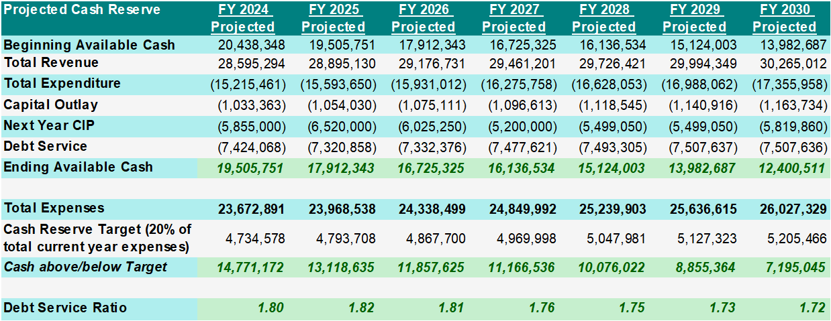
Sanitary Sewer Cash Reserve Projection

Slide 8
8

Slide 9
9

Slide 10
10

Slide 11
11

Slide 12
Henderson Branch Sewer
Challenges
Coordination with MoDOT Interstate 70 improvement project
Coordination with the Boone County Regional Sewer District as it relates to providing sewer outside the corporate limits of the City.
12

